Slide 1
UML502
Lab 2

Slide 2
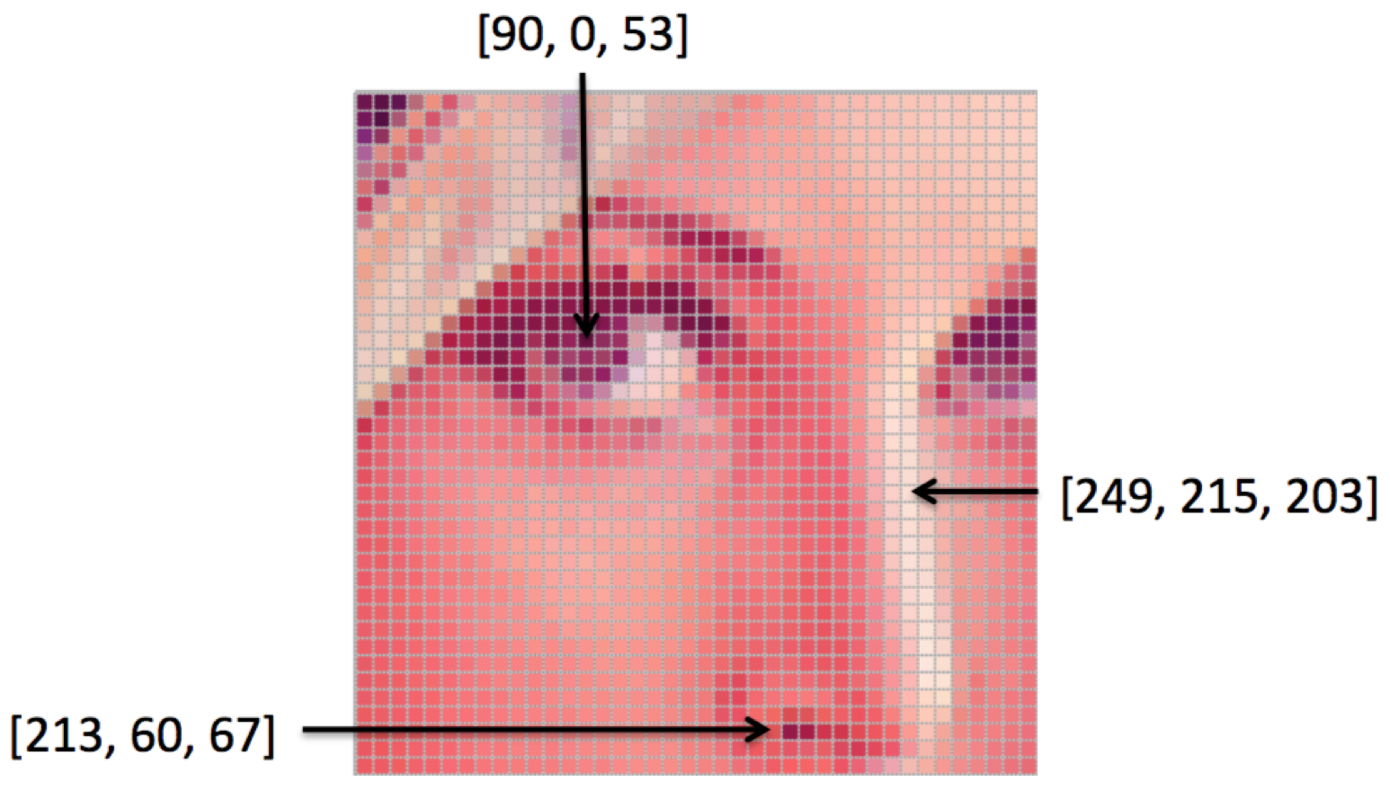
Image Properties
Size – This is the height and width of an image. It can be represented in centimeters, inches or even in pixels.
Color space – Examples are RGB and HSV color spaces.
Channel – This is an attribute of the color space. For example, RGB color space has three types of colors or attributes known as Red, Green and Blue (hence the name RGB).

Slide 3
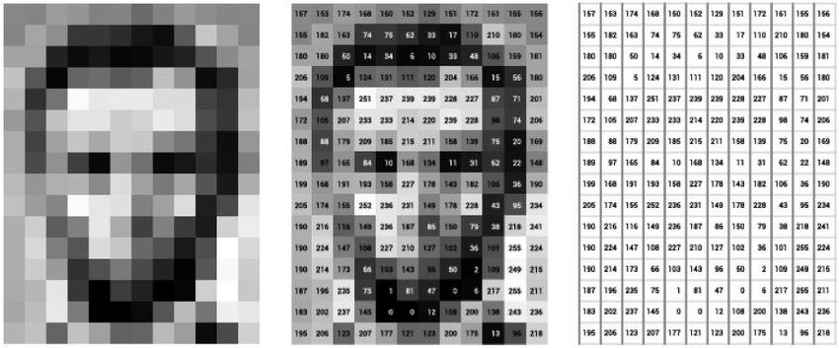
RGB images vs grayscale images
It is important to distinguish between RGB images and grayscale images.
An RGB image has three color channels: Red channel, Green channel and Blue channel. However, a grayscale image has just one channel

Slide 4
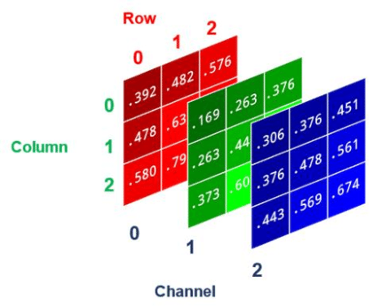
Q4 Assignment 1
A channel = one matrix of numbers that describes a certain aspect of an image.
In digital images:
RGB image → 3 channels: Red, Green, Blue.
Grayscale image → 1 channel: intensity (brightness) only.
the shape of an array refers to the dimensions of that array

Slide 5
Image = Array of Numbers
1: arr.shape[-1]
arr.shape gives the tuple of dimensions.
arr.shape[-1] = last dimension.
If RGB image → (H, W, 3) → arr.shape[-1] = 3
If Grayscale image → (H, W) → no last channel → you won’t use this.
2. reshape(-1, arr.shape[-1])
-1 means: “let NumPy figure this dimension out.”
arr.shape[-1] fixes the number of columns.
Saving the image as a text file forces you to see that images are just arrays of numbers (pixels). But, why no direct conversion of image to text?
Computers represent an image as a matrix of pixel values.
NumPy makes those numbers accessible
Human Readability
Easy Portability
A text file can be shared without worrying about image formats.
Another person can just load it with np.loadtxt() and reconstruct the array.
# Convert image to numpy array
arr = np.array(img)
np.savetxt(save_path, arr.reshape(-1, arr.shape[-1]) if len(arr.shape) == 3 else arr, fmt='%d’)
loaded_rgb = np.loadtxt("rgb_output.txt", dtype=int)
loaded_rgb = loaded_rgb.reshape(-1, 3)
arr.shape[-1] = last dimension = 3 (the R, G, B values).
-1 means “figure out how many rows automatically”.
So it flattens the (H, W, 3) array into a 2D array:(H*W, 3)

Slide 6
Another Example
import numpy as np
arr = np.array([[[255, 0, 0], [0, 255, 0]], [[0, 0, 255], [255, 255, 255]]])
print(arr.shape)
reshaped = arr.reshape(-1, arr.shape[-1])
print(reshaped.shape)
print(reshaped)
# (2, 2, 3)
# (4, 3)

Slide 7
What we learned?
Image processing with PIL & NumPy.
Handling different image types (RGB vs Grayscale).
Saving arrays as text files (np.savetxt).
Reloading arrays in Jupyter Notebook.

Slide 8
Introduction to Data and Dataset

Slide 9
What is Data ?
Data refers to individual facts, measurements, or observations. (Datum-singular)
These are raw, unprocessed pieces of information
Examples:
A single temperature reading: 28°C
A single user name: "John Doe”
A single sales figure: ₹5000
Multiple temperature readings: 28°C , 30°C , 34°C , 29°C , 25°C
Multiple user names: “John Doe”, “Alice, “Rachel”
Multiple sales figure: ₹5000, ₹4000, ₹3000, ₹1000
Datum: Single piece of information, smallest unit of data
Data: Multiple data points/ values
Notes:
Datums – data points
Data represent a collection of data points

Slide 10
What is Data ? (contd…)
Nature: Data can be structured, semi-structured, or unstructured
Granularity: It's the smallest unit of information that is meaningful
Notes:
Datums – data points
Data represent a collection of data points

Slide 11
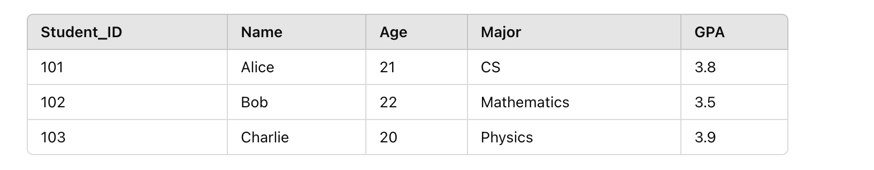
What is Dataset ?
Collection of data objects and their attributes.
Data Object (Row 1): {101, Alice, 21, CS, 3.8}
Data Object (Row 2): {102, Bob, 22, Mathematics, 3.5}
Attributes (Columns): Student_ID, Name, Age, Major, GPA
Data Points (Individual Values): 101, Alice, 21, etc.
Notes:
Data Object refers to an entity or instance in the dataset. It is usually a row in a table that represents one complete record.Data Point usually refers to an individual measurement or value within a data object.

Slide 12
What is Dataset ?
An attribute is a property or characteristic of an object:
Examples: eye color of a person, temperature, etc.
Attribute is also known as variable, field, characteristic, dimension, or feature
A collection of attributes describe an object:
Object is also known as record, point, case, sample, entity, or instance
In case of ML
In case of ML

Slide 13
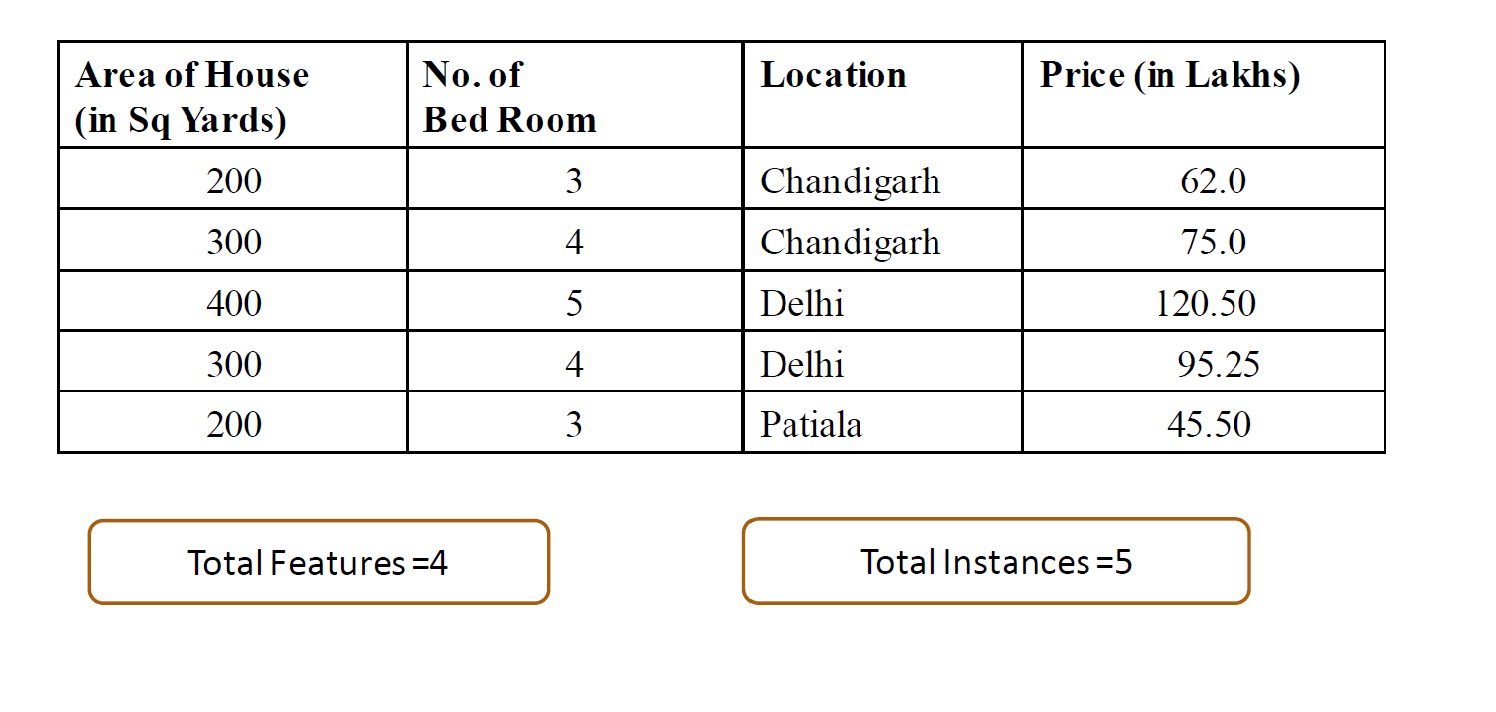
Dataset
Label/ Target/ Outcome/Dependent Variable (Y)
Y={Price in Lakhs}
Features/Dimension/Attributes of Dataset
X ={Area, No. of bed room, Location}

Slide 14
Dataset Classification
On the basis of Structure
On the basis of Machine Learning Usage
On the basis of label
On the basis of data type
Structured
Semi-Structured
Un-Structured
Training
Test
Validation
Labelled
Unlabelled
Qualitative
Quantitative

Slide 15
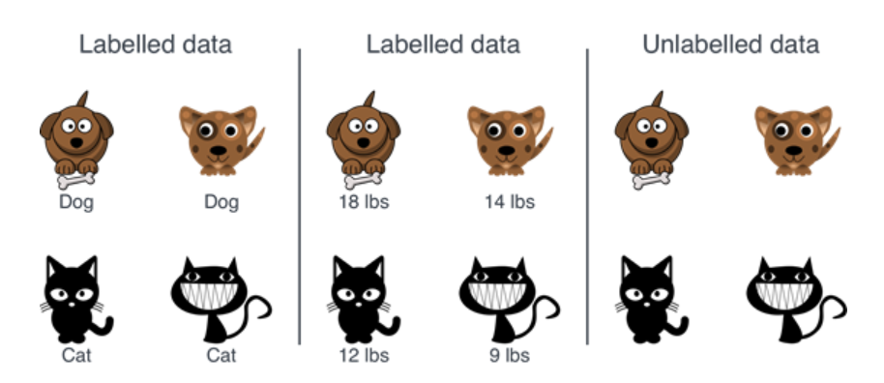
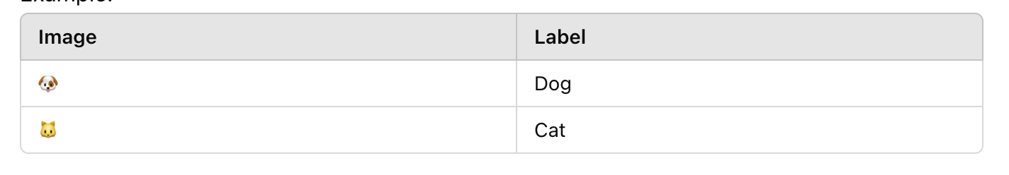
Labelled Dataset
Labelled Dataset-:
Labelled dataset contains both input data (features) and corresponding output data (labels or targets).
Each data point has an associated label that provides the correct answer or classification.
Characteristics:
Contains Labels: Each data point has a predefined outcome (e.g., "cat" or "dog" in image classification).
Example:
For an image of a cat, the label might be "cat" .
In a dataset for house prices, features like area and number of rooms, locations are inputs, and the price is the output or label.

Slide 16
Unlabelled Dataset
Unlabelled Dataset-:
A dataset is unlabelled when it contains only input data (features) without any corresponding labels.
The outcomes or groupings are unknown, and the task is to infer structure or patterns in the data.
Characteristics:
No Labels: The dataset has only input data without predefined outcomes.
Examples:
Images without labels (e.g., no indication whether an image is a "cat" or "dog").
Sensor data where patterns need to be discovered (e.g., IoT data).

Slide 17
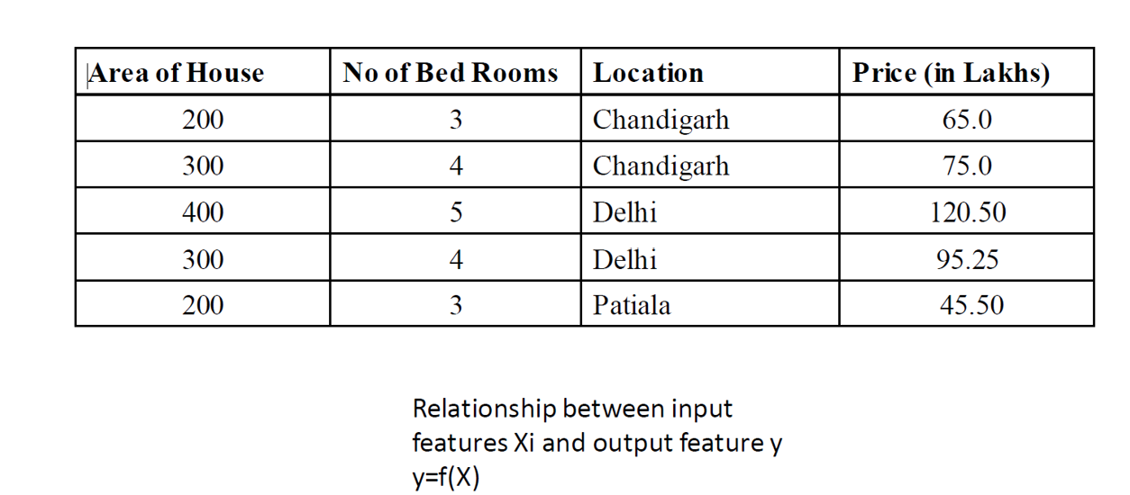
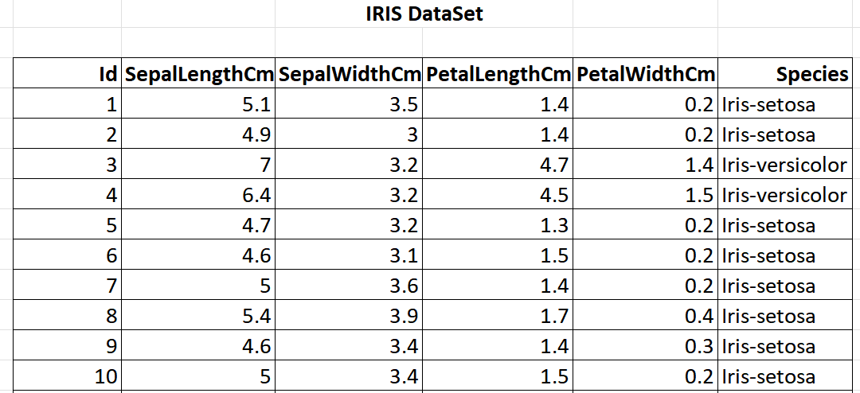
Labelled Dataset
Price is the Label
Inputs- Id, SepalLength, SepalWidth, PetalLength, PetalWidth
Output/Target variable- Species
A dataset for house prices
Dataset for flowers’ species
Species is the Label
Inputs-Area of House, No. of Bed Rooms, and Location
Output/Target variable- Price

Slide 18
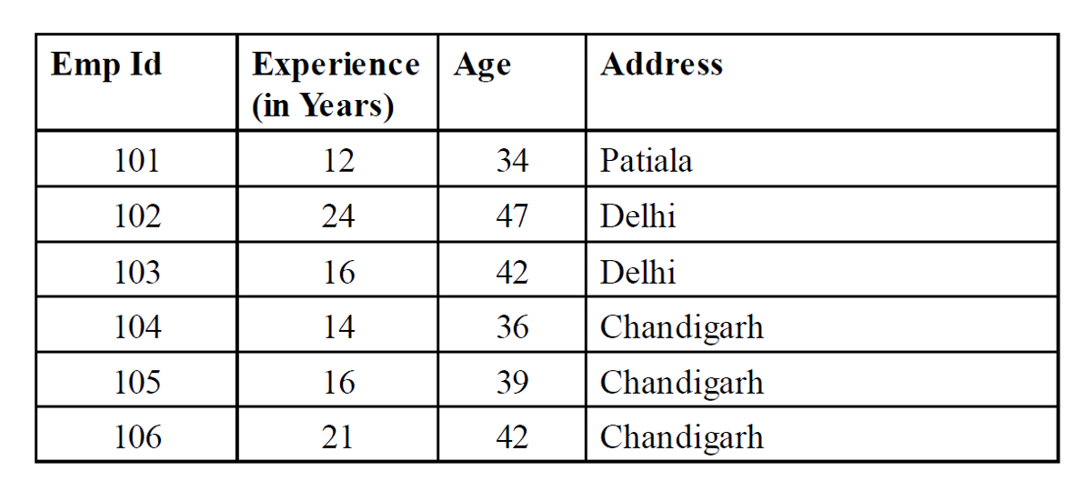
Unlabelled Dataset
Dataset for Employee
Inputs- Emp Id, Experience, Age, Address
Output/Target variable- Does not include the output/target variable.

Slide 19
Attribute/Features Values
Attribute or feature values are numbers or symbols assigned to an attribute or feature for a particular object
Distinction between attributes and attribute values:
Same attribute can be mapped to different attribute values.
Example: Height can be measured in feet or meters.
Different attributes can be mapped to the same set of values.
Example: Attribute values for ID and age are integers.

Slide 20
Types of Features/ Attribute
Features
Qualitative
Qualities
Nominal
No inherit order
Ordinal
Meaningful order
Quantitative
Quantities
Interval
No true Zero-point
Ratio
True Zero point
Binary
2 states

Slide 21
Qualitative Features
Qualitative features represent categories or qualities.
These are also called categorical variables.
Non-numerical, thus no arithmetic operations
Gender (Male, Female), Color (Red, Blue), Eye color, Grades (A,B,C)
Types of Qualitative Features:
Nominal Features
Ordinal Features

Slide 22
Qualitative Features
Nominal Features:
Categories with no inherent order or ranking.
Examples:
Colors: {Red, Blue, Green}
Gender: {Male, Female, Non-binary}
Types of vehicles: {Car, Truck, Bike}
Binary:
Nominal attribute with only 2 states (0 and 1)
Symmetric binary: both outcomes equally important e.g., gender
Asymmetric binary: outcomes not equally important. e.g., medical test (positive vs. negative)
Convention: assign 1 to most important outcome (e.g., HIV positive)

Slide 23
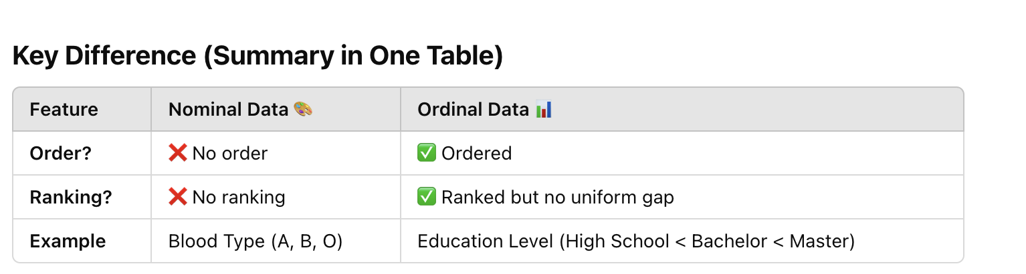
Qualitative Features
Ordinal Features:
Categories with a meaningful order, but the differences between them are not measurable.
Examples:
Education level: {High School, Bachelor’s, Master’s, PhD}
Likert scale: {Strongly Disagree, Disagree, Neutral, Agree, Strongly Agree}
Size: {Small, Medium, Large}

Slide 24
Qualitative Features - Characteristics
Cannot perform arithmetic operations (e.g., addition, subtraction).
Usually represented as strings or encoded as numbers.
{High School, Bachelor’s, Master’s, PhD}
{10, 4, 2, 5}

Slide 25
Quantitative Features
Quantitative features represent numerical values (Continuous or Discrete).
These are also called numerical variables.
Numerical variables can have Continuous or Discrete value.

Slide 26
Quantitative Features
Discrete values:
Represent countable values (integers).
Examples:
Number of students in a class: {10, 15, 20}
Number of cars owned: {0, 1, 2, 3}
Continuous values:
Represent measurable values on a continuous scale.
They can take any value within a range.
Examples:
Temperature: {36.5°C, 37.2°C}
Height: {165.2 cm, 170.8 cm}
Income: ₹45,500.75
Can only take specific, distinct values.
No intermediate values exist between two numbers
Can take any value within a given range.
Has infinite possibilities within an interval.

Slide 27
Types of Quantitative Features
1. Interval Data
Numerical data where the difference between values is meaningful, but there is no true zero point, ratios are meaningless.
Characteristics:
The intervals between values are equal and meaningful.
Arithmetic operations like addition and subtraction are valid.
Ratios cannot be calculated since there is no true zero.
Examples:
Temperature in Celsius or Fahrenheit (e.g., 10°C is not "twice as hot" as 5°C because 0°C doesn’t mean "no temperature").
Dates (e.g., 2000 AD is not twice as old as 1000 AD).
Key Note: Zero is arbitrary and does not indicate the absence of the variable being measured.
Notes:
Differences between values are meaningful (10°C to 20°C is the same difference as 20°C to 30°C). ❌ No true zero → 0°C does not mean "no temperature" (it is just another point on the scale). ❌ Ratios are meaningless → 20°C is NOT twice as hot as 10°C.

Slide 28
Types of Quantitative Features
2. Ratio Data
Ratio data is numerical data where the difference between values is meaningful, and there is a true zero point (i.e., zero indicates "nothing") and ratios are meaningful.
Characteristics:
Both addition/subtraction and multiplication/division are valid.
Ratios are meaningful (e.g., 4 is twice as large as 2).
Contains a true zero, which represents the total absence of the variable.
Examples:
Height (e.g., 0 cm means no height).
Weight (e.g., 0 kg means no weight).
Income (e.g., ₹0 means no income).
Temperature in Kelvin (0 K represents the absence of thermal energy).
Notes:
✅ Differences are meaningful (100 cm to 150 cm is a 50 cm difference). ✅ True zero exists → 0 cm means “no height” (absolute absence). ✅ Ratios are meaningful → A person who is 180 cm is twice as tall as someone who is 90 cm.

Slide 29
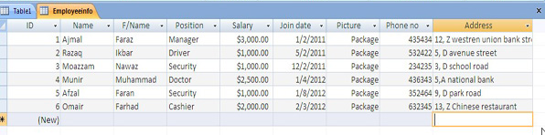
Structured data
Data that can be processed, stored, and retrieved in a fixed format.
It refers to highly organized information that can be readily and seamlessly stored and accessed from a database by simple search engine algorithms.
Example-The employee table in a company database will be structured as the employee details, their job positions, their salaries, etc., will be present in an organized manner.

Slide 30
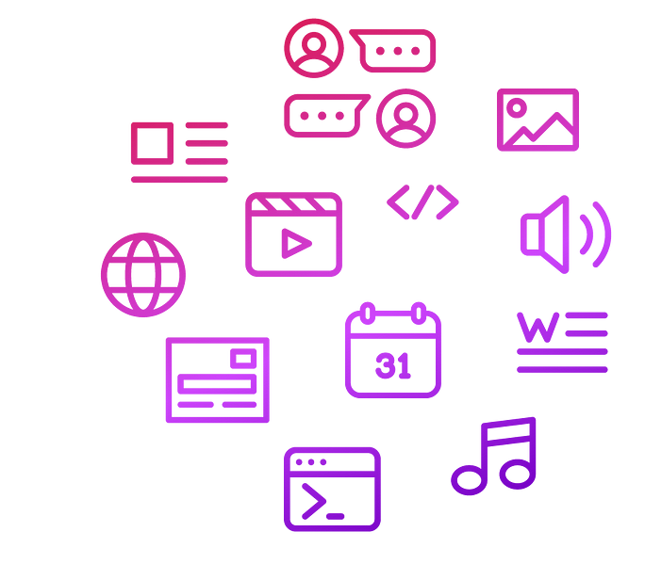
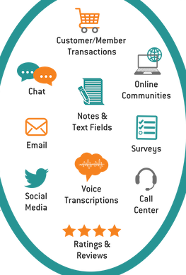
Unstructured data
Refers to the data that lack any specific form or structure whatsoever.
This makes it very difficult and time-consuming analyze unstructured data.
Stored in data lakes, NoSQL (Not Only Structured Query Language) databases, or cloud-based systems.
Free-form or undefined format (e.g., text, images, videos, audio).

Slide 31
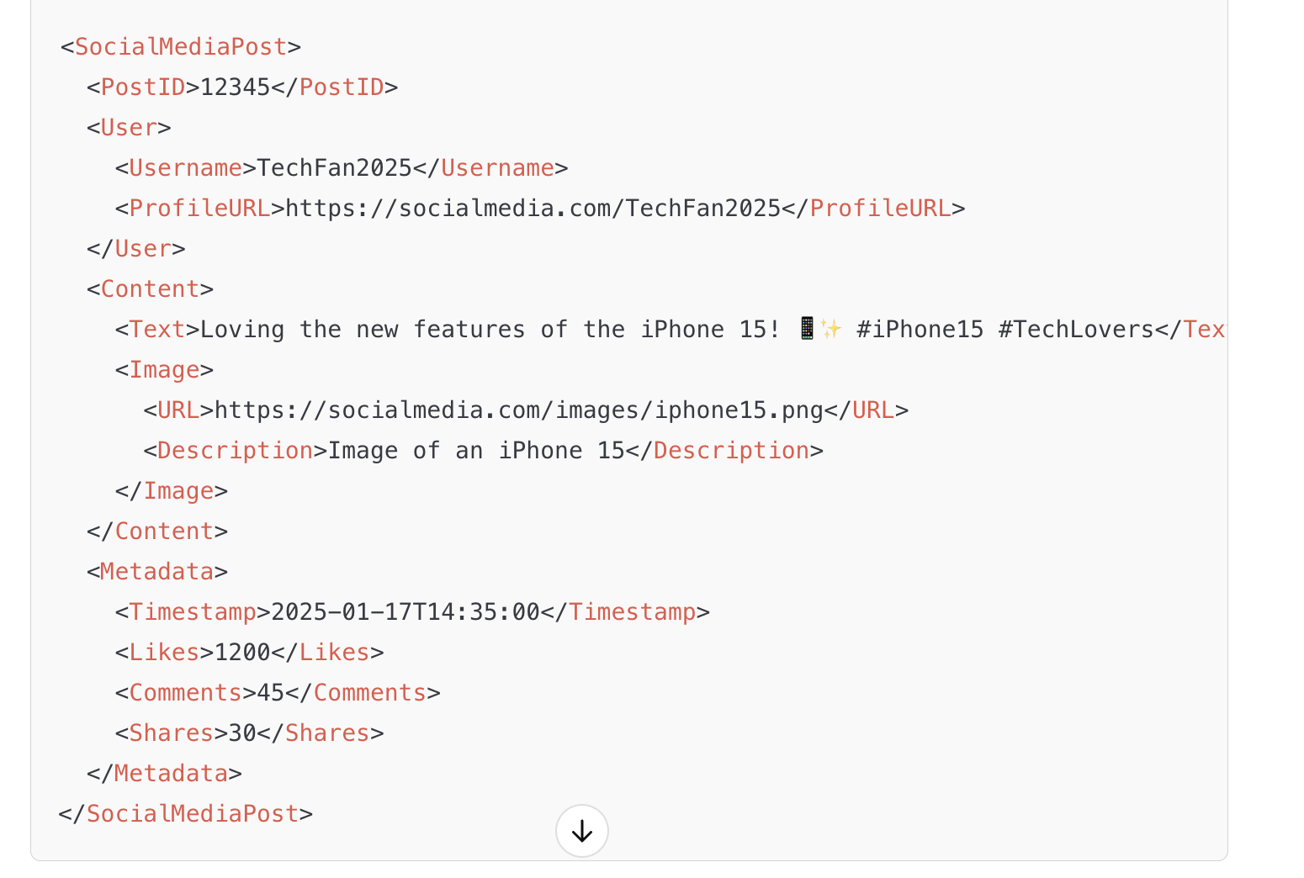
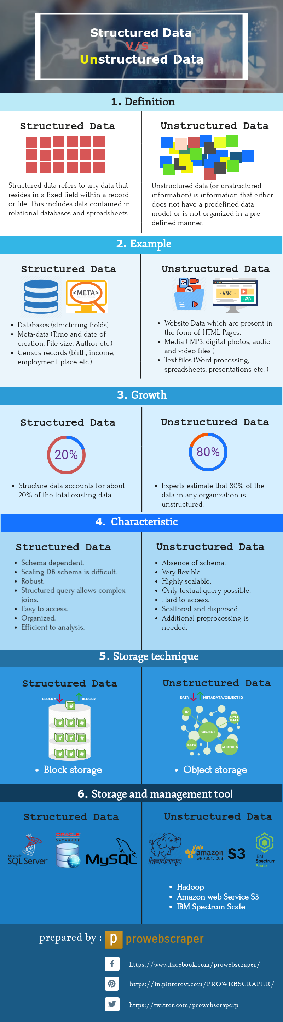

Slide 32

Semi-structured data
Pertains to the data containing both the formats mentioned above, that is, structured and unstructured data.
To be precise, it refers to the data that although has not been classified under a particular repository (database), yet contains vital information or tags that segregate individual elements within the data.
Example- Email
The written content of an email is unstructured, whereas the there are some inherent structure to the information in each email, such as the sender’s name, recipient address, recipient name and date sent.

Slide 33
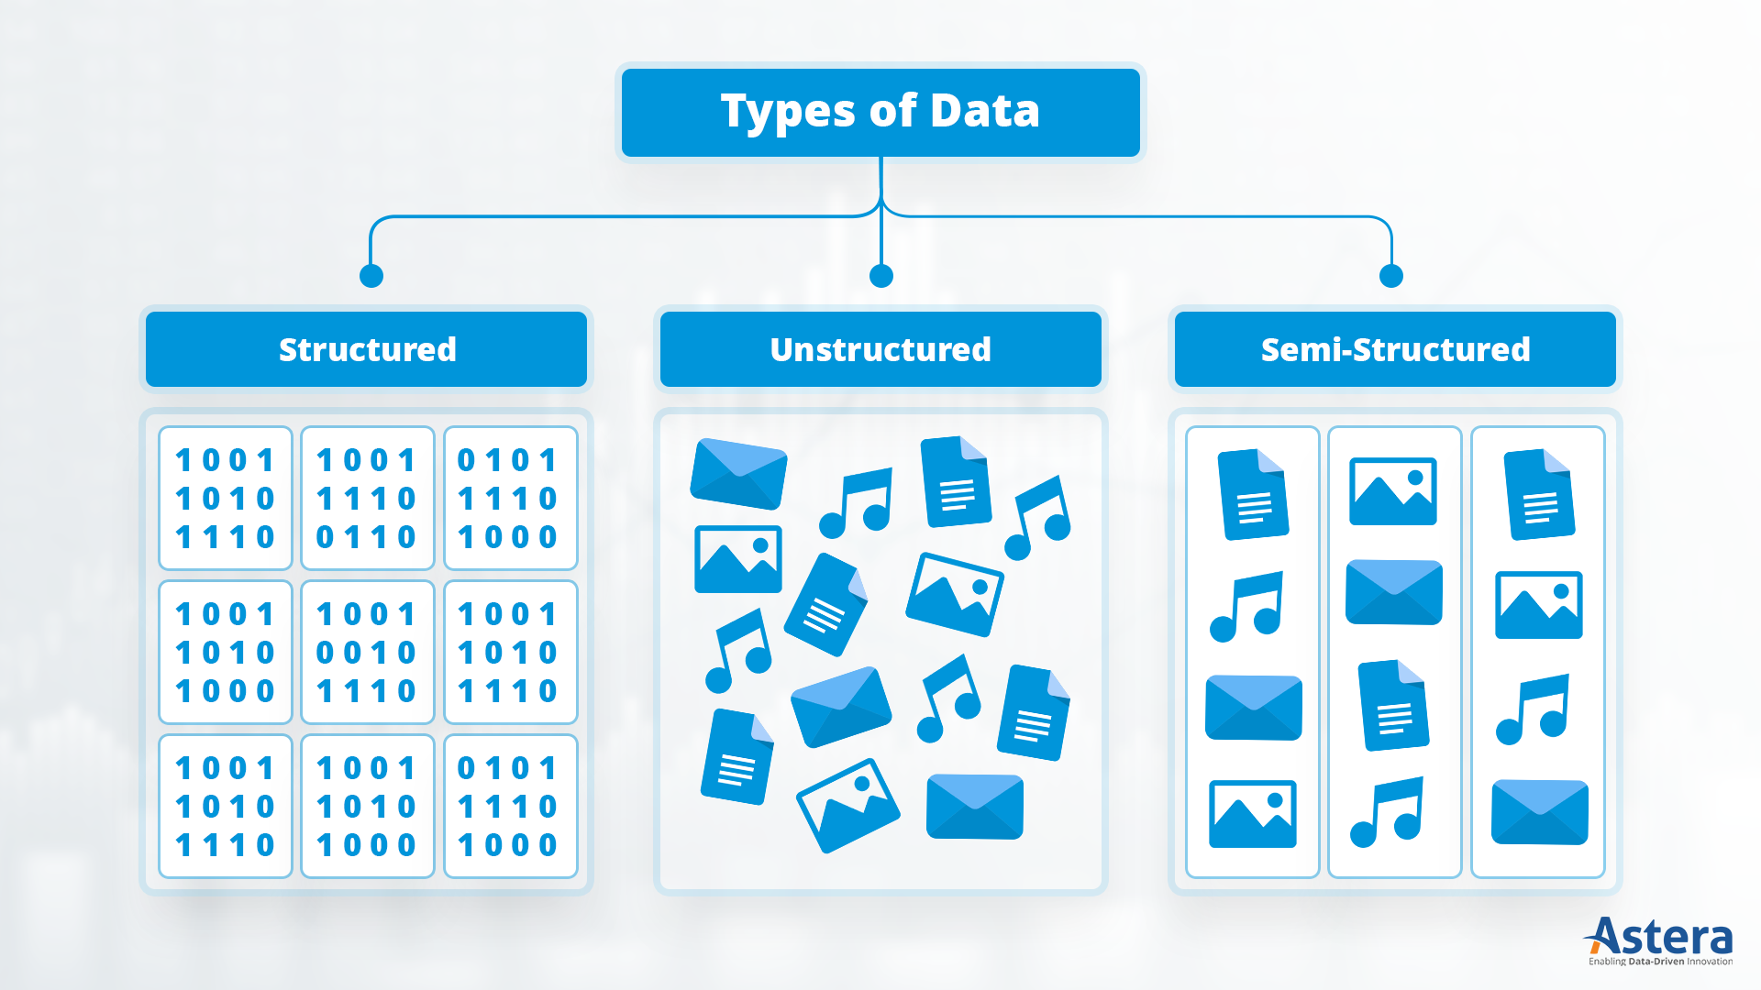
Bank Transactions:
Fields: Transaction ID, Account Number, Date, Amount, Merchant Name.
Social Media Posts:
Facebook posts, tweets, Instagram captions, and hashtags.
Emails with Metadata:
The body is unstructured, but metadata like sender, receiver, subject, and timestamp is structured.

Slide 34
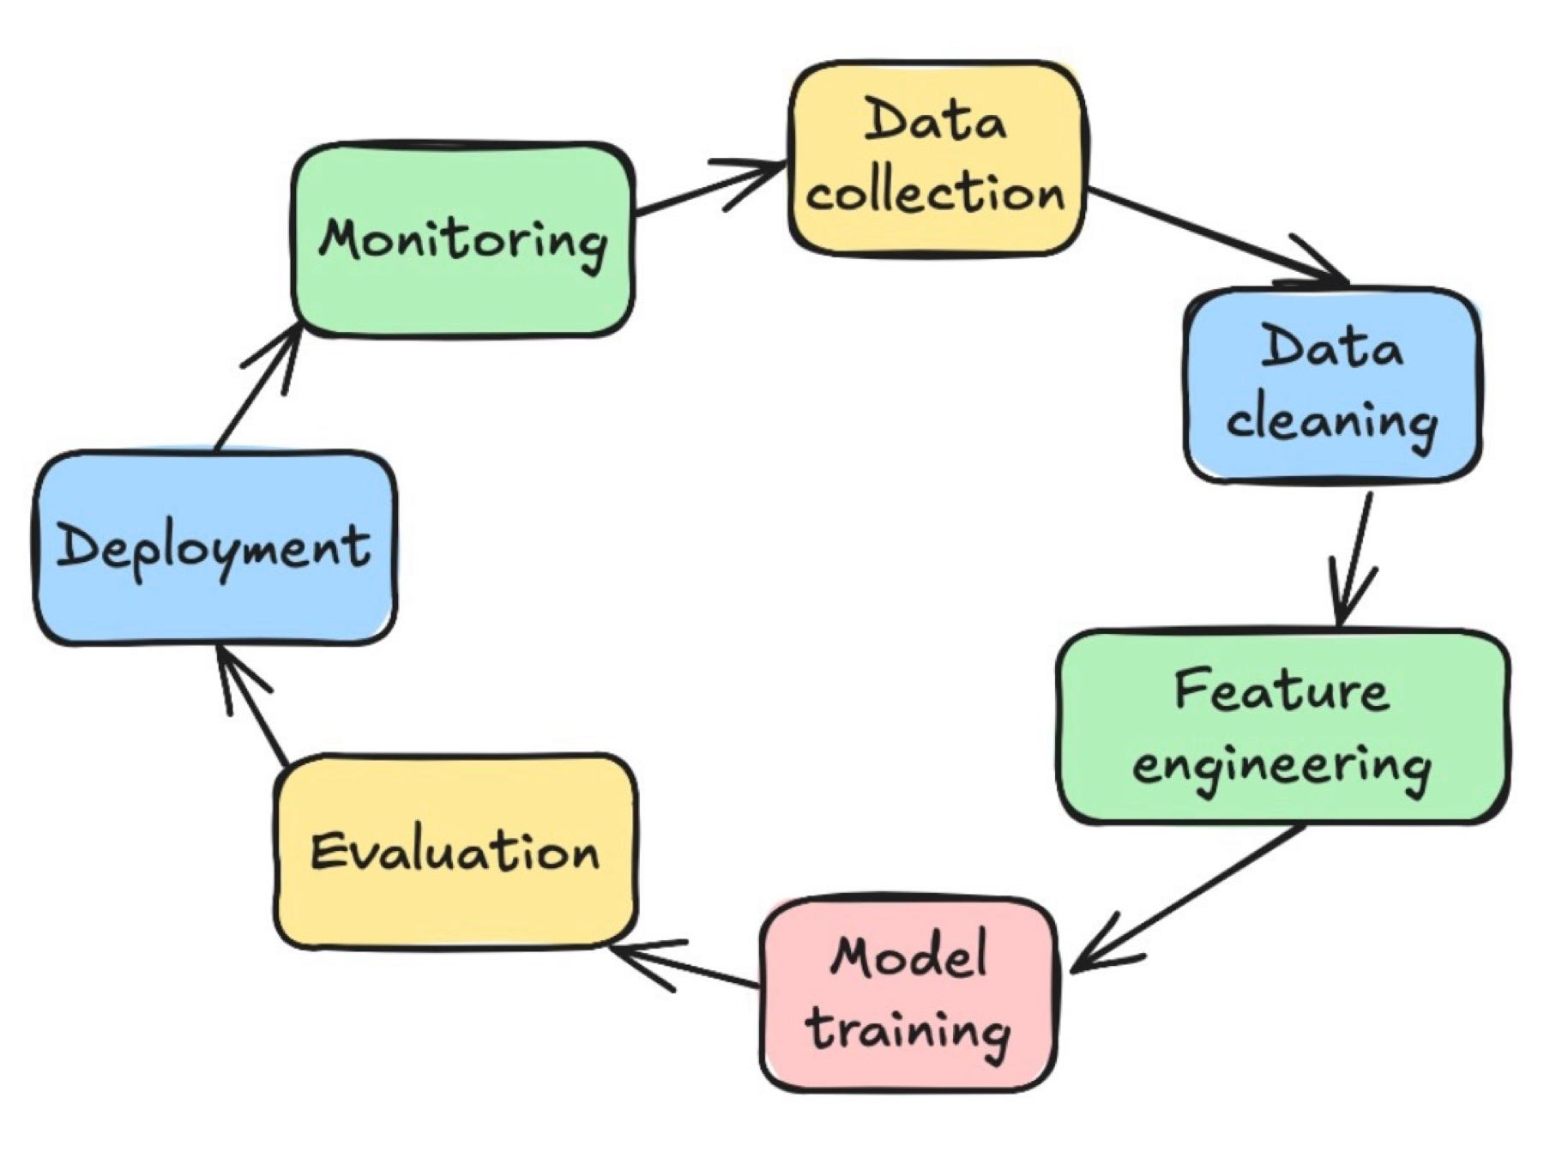

Slide 35
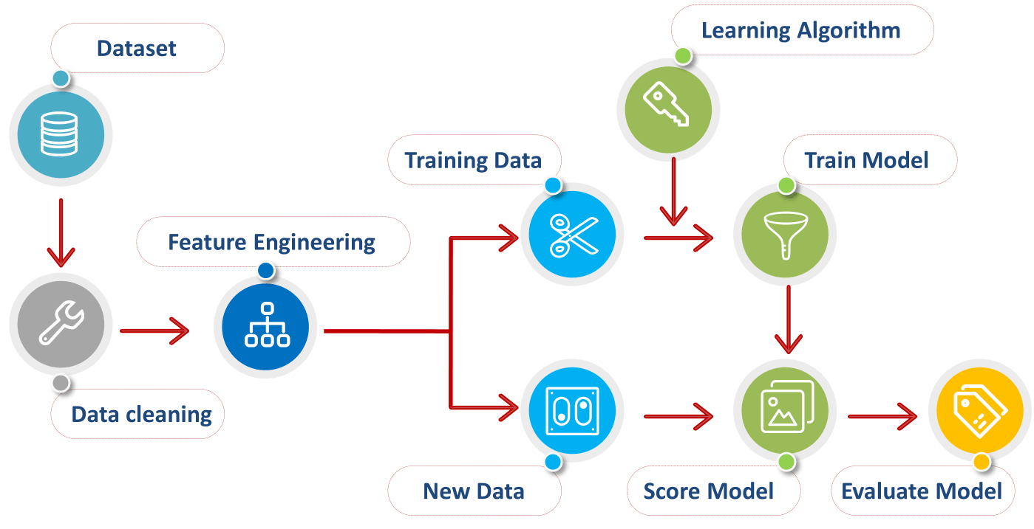

Slide 36

DATA PREPROCESSING

Slide 37

01
Sources of Data
02
Web Scraping
What We'll Cover
03
Popular Scraping Libraries
04
Data Annotation Basics
05
Tools & Best Practices

Slide 38

Collecting Data
Manual Collection
Involves gathering data by hand, through surveys, forms, or curated downloads. Useful for small or niche datasets.
Public Sources
Open datasets from platforms like Kaggle, UCI, or government portals offer diverse, well-documented datasets.
APIs & Databases
APIs like Twitter or Reddit APIs allow structured data pulls; internal databases are often used for business-specific ML.

Slide 39
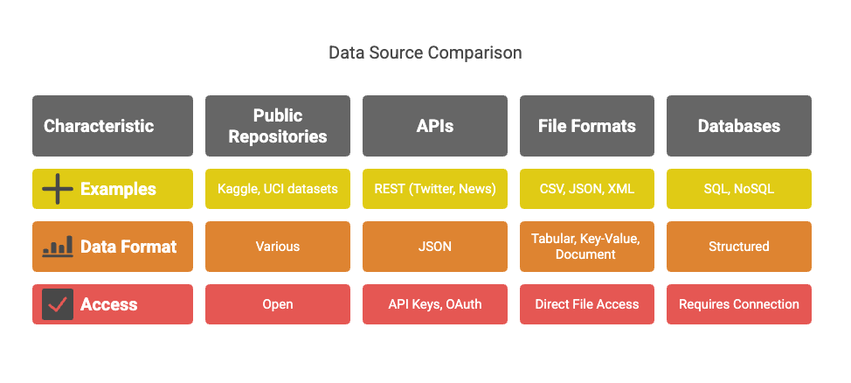
Understanding where data comes from is critical.
a. Public Repositories:
Kaggle Datasets: https://www.kaggle.com/datasets
UCI Machine Learning Repository: https://archive.ics.uci.edu/ml/
b. APIs:
REST APIs (e.g., Twitter, News API, Google Maps)
Typically return JSON data
Require API keys or OAuth
c. File Formats:
CSV – Common for tabular data
JSON – Key-value structure, used with APIs
XML – Document structure, used in legacy systems
d. Databases:
SQL (MySQL, PostgreSQL)
NoSQL (MongoDB, Firebase)

Slide 40

Scraping Data
What is Web Scraping?
Web Scraping is the automated process of extracting data from websites. It allows access to large amounts of unstructured data.
How the Web Works:
Websites are rendered using HTML
You interact via HTTP requests (GET, POST)
Responses contain structured info (tables, divs, spans)
Legal & Ethical Concerns
Always check the site’s terms of service. Avoid scraping personal or copyrighted content without permission.
Scraping Targets
E-commerce, news, social media, and public records are common scraping targets for ML training data.

Slide 41

Popular Scraping Libraries
BeautifulSoup (simplest): Parses HTML into searchable objects.
A Python library for parsing HTML and XML. It’s beginner-friendly and works well with static pages.
Scrapy (advanced): For large-scale and structured scraping.
A powerful framework for large-scale scraping with built-in handling for requests, pipelines, and spiders.
Selenium (Used when content loads dynamically via JavaScript.)
Simulates browser behavior and can scrape JavaScript-heavy websites by automating browser interaction.

Slide 42
Data Collection Using APIs
APIs provide structured access to live data streams.
a. Anatomy of an API:
Endpoint: URL for the resource
Method: GET/POST/PUT/DELETE
Headers: Metadata, tokens
Response: Usually in JSON
b. Tools:
requests in Python
tweepy for Twitter
newsapi-python for news articles
c. Example:
import requests
url = "https://newsapi.org/v2/top-headlines?country=in&apiKey=YOUR_KEY"
response = requests.get(url)
data = response.json()
for article in data['articles'][:5]:
print(article['title'])

Slide 43
Challenges in Data Collection
Incomplete data | APIs return partial results
Dynamic websites | Require JavaScript rendering (need Selenium)
Rate limits | Many APIs allow only X requests/hour
Legal restrictions | Data scraping can violate ToS or data laws
Bias | Source of data may skew outcomes
Anonymization | Sensitive data must be stripped of PII (Personally Identifiable Information)

Slide 44

What is Data Annotation?
Why Annotate?
Machine learning models need labeled data for supervised learning. Annotations provide ground truth for training.
Common Types
Classification labels, bounding boxes, segmentation masks, and entity recognition tags are common annotations.
Impact on Accuracy
High-quality annotations lead to better model performance, while poor labeling introduces noise and errors.

Slide 45
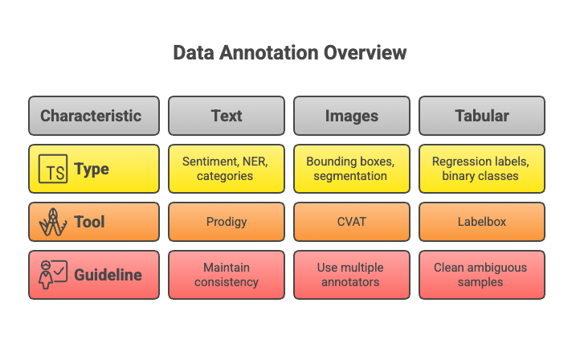
Machine learning models (esp. supervised) require labeled data.
a. Types:
Text: Sentiment, NER, categories
Images: Bounding boxes, segmentation
Tabular: Regression labels, binary classes
b. Tools:
Labelbox (cloud-based)
CVAT (open-source, for images)
Prodigy (for text/NLP)
LightTag (team annotation)
c. Guidelines:
Maintain consistency
Use multiple annotators for reliability
Clean ambiguous samples

Slide 46
Annotation Tools & Methods
Manual Annotation
Platform Solutions
Automation Aids
Tools like LabelImg or VGG Image Annotator are great for small, focused datasets.
Services like Labelbox, Scale AI, and SuperAnnotate offer scalable and collaborative labeling workflows.
Active learning and semi-supervised techniques help reduce human workload and improve speed.

Slide 47
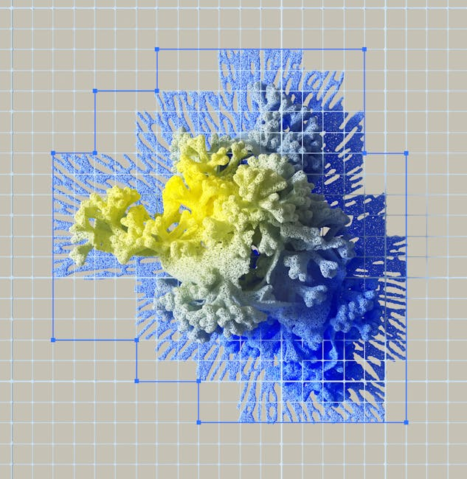
• Always consider data privacy and user consent.
• Respect copyright and licensing restrictions.
• Automate wisely: balance speed with annotation quality.
• Validate data with domain experts when possible.
• Keep a consistent format and schema.
Challenges & Best Practices
Ethical and Practical Considerations

Slide 48
Annotation Strategy
How do you balance data quantity vs. quality?
Discussion & Reflection
Larger datasets may boost performance, but only if the labels are reliable. Prioritizing high-quality, well-annotated data often yields better results in real-world ML scenarios.

Slide 49
Data Preprocessing
Handling Missing Values
Normalization
Standardization
Discretization
Binarization

Slide 50
Handling Missing Values
Missing data can distort your analysis or prevent algorithms from running, so you need to decide whether to remove or fill them.
Types of Missingness
MCAR – Missing Completely at Random
The missing value has nothing to do with other variables.
Example: A survey sheet torn and a random age value is lost.
MAR – Missing at Random
Missingness depends on other variables.
Example: Salary data missing more often for younger respondents.
MNAR – Missing Not at Random
Missingness depends on the missing value itself.
Example: People with very high salaries refuse to disclose them.

Slide 51
Handling Missing Values
Techniques
Delete Rows: Use if only a small percentage is missing.
df.dropna(inplace=True)
Replace with Mean/Median/Mode:
df['Age'].fillna(df['Age'].mean(), inplace=True)
KNN or Regression Imputation: Predict missing values using other features.
Interpolation: For time series, fill gaps with trends.
df['Temperature'].interpolate(inplace=True)

Slide 52
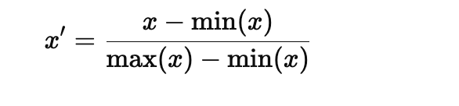
Normalization
Scales features so all numeric values fall within the same range (e.g., 0 to 1).
Important for algorithms that are sensitive to magnitude, like KNN or neural networks.
Min-Max Normalization Formula
from sklearn.preprocessing import MinMaxScaler
scaler = MinMaxScaler()
df[['Income']] = scaler.fit_transform(df[['Income']])

Slide 53

Standardization
Transforms data to have mean = 0 and standard deviation = 1.
Used in algorithms like SVM or logistic regression.
Formula
from sklearn.preprocessing import StandardScaler
scaler = StandardScaler()
df[['Age']] = scaler.fit_transform(df[['Age']])

Slide 54
Discretization
Turns continuous variables into categories, useful when exact numeric precision isn’t needed or to reduce noise.
Methods
Equal-Width Binning – Divide the range into equal intervals. Example: Age bins: 0–20, 21–40, 41–60.
pd.cut(df['Age'], bins=3, labels=["Young", "Middle", "Old"])
Equal-Frequency Binning – Each bin has the same number of samples.
Equal-frequency binning divides data into k bins so that each bin contains (approximately) the same number of observations.
This is different from equal-width binning, where the range is divided into equal intervals.
[5, 7, 8, 10, 15, 20, 21, 25, 26, 30]
Bin 1 → [5, 7, 8, 10, 15]
Bin 2 → [20, 21, 25, 26, 30]
df['Score_bin'] = pd.qcut(df['Score'], q=2, labels=["Low", "High"])

Slide 55
Binarization (One Hot Encoding)
Converts categorical variables into binary columns.
Gender: Male, Female → Male=1, Female=0 (or two separate columns)
pd.get_dummies(df, columns=['Gender'])
If Gender = [Male, Female, Female], output:
Gender_Female Gender_Male
0 0 1
1 1 0
2 1 0

Slide 56
Person | Gender | MaritalStatus | Occupation
P1 | Male | Single | Engineer
P2 | Female | Married | Teacher
P3 | Male | Married | Doctor
Person | Gender_Male | Gender_Female | MaritalStatus_Single | MaritalStatus_Married | Occupation_Engineer | Occupation_Teacher | Occupation_Doctor
P1 | 1 | 0 | 1 | 0 | 1 | 0 | 0
P2 | 0 | 1 | 0 | 1 | 0 | 1 | 0
P3 | 1 | 0 | 0 | 1 | 0 | 0 | 1

Slide 57
Example:
'Gender': ['Male', 'Female', 'Female', 'Male’]
Label Encoding:
Assigns an integer to each category.
Simple, but may introduce an unwanted ordinal relationship.
Gender: Male → 1, Female → 0
Ordinal Encoding
Similar to label encoding, but order matters.
You assign numbers based on rank or importance.
Size: Small → 1, Medium → 2, Large → 3

Slide 58
Similarity and Correlation Analysis
Comes after data preprocessing
Once you’ve:
Scaled all numeric attributes to the same range (normalization/standardization)
Binarized nominal attributes (one-hot encoding)
Possibly discretized numeric attributes into bins
…then your dataset is ready for similarity and correlation measures. This ensures the metrics you calculate are fair and comparable across features.

Slide 59
Similarity Measures
Similarity Matching Coefficient (SMC)
Jaccard Similarity
Cosine Similarity

Slide 60
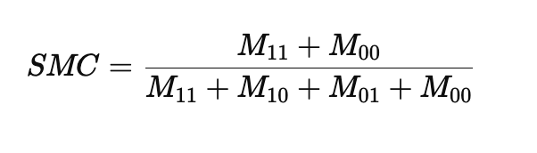
Similarity Measures
Similarity Matching Coefficient (SMC)
Used when comparing binary attributes (0/1)
Counts both 1-1 and 0-0 matches
Eg: Obj1: [1, 0, 1, 0]
Obj2: [1, 1, 1, 0]
SMC = 3/4 = 0.75

Slide 61
Similarity Measures
Jaccard Similarity Coefficient (Jaccard Index, Jaccard Coefficient, Jaccard Dissimilarity, and Jaccard Distance)
The Jaccard similarity (J) between two sets, A and B, is calculated as:
J(A, B) = |A ∩ B| / |A ∪ B|
Jaccard Distance = 1 — Jaccard Similarity
Suited for binary or categorical data.
If your features are numerical, you may need to discretize or convert them into appropriate set or binary representations before applying Jaccard similarity.

Slide 62
Jaccard Similarity
import numpy as np
from sklearn.metrics import jaccard_score
# Define two binary vectors
A = np.array([1, 1, 0, 1, 0, 1, 0])
B = np.array([1, 0, 0, 1, 1, 1, 0])
# Compute Jaccard Similarity
similarity = jaccard_score(A, B)
# Print result
print(f"Jaccard Similarity: {similarity:.2f}") //0.6

Slide 63

Similarity in Texts
text1 = set("machine learning is fun".split())
text2 = set("learning about machine intelligence".split())
jaccard = len(text1 & text2) / len(text1 | text2)
print("Jaccard Similarity:", jaccard)
Jaccard Similarity: 0.3333333333333333
Person | Gender | MaritalStatus | Occupation
P1 | Male | Single | Engineer
P2 | Female | Married | Teacher
Jaccard = 0

Slide 64
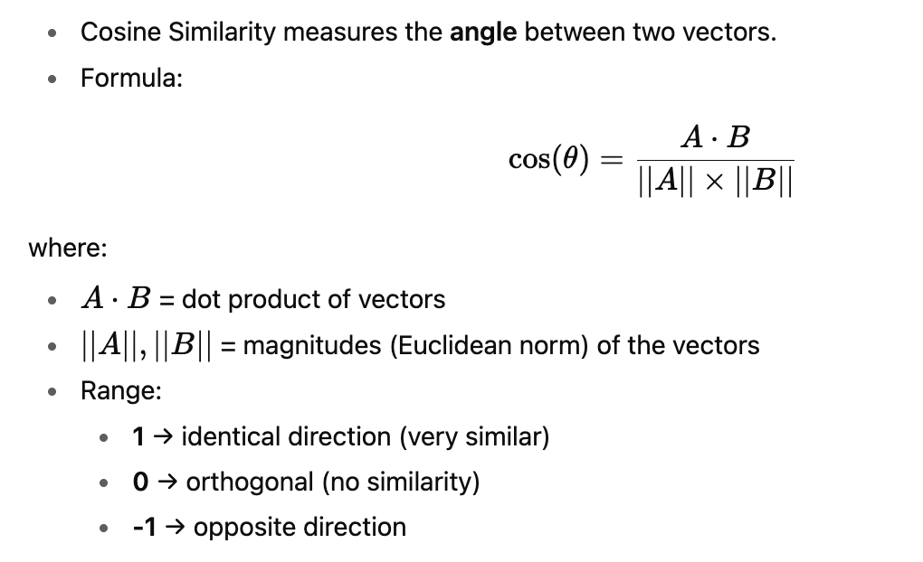
Similarity Measures
Cosine Similarity
Cosine similarity is a valuable metric for measuring the similarity between vectors, especially in high-dimensional and sparse datasets, by focusing on direction rather than magnitude
Useful for numerical data

Slide 65
Original Data:
Gender MaritalStatus Occupation
0 Male Single Engineer
1 Male Married Teacher
After One-Hot Encoding:
Gender_Male MaritalStatus_Married MaritalStatus_Single Occupation_Engineer Occupation_Teacher
1.0 0.0 1.0 1.0 0.0
1.0 1.0 0.0 0.0 1.0.
Cosine Similarity between Obj1 and Obj2: 0.33333333333333337

Slide 66
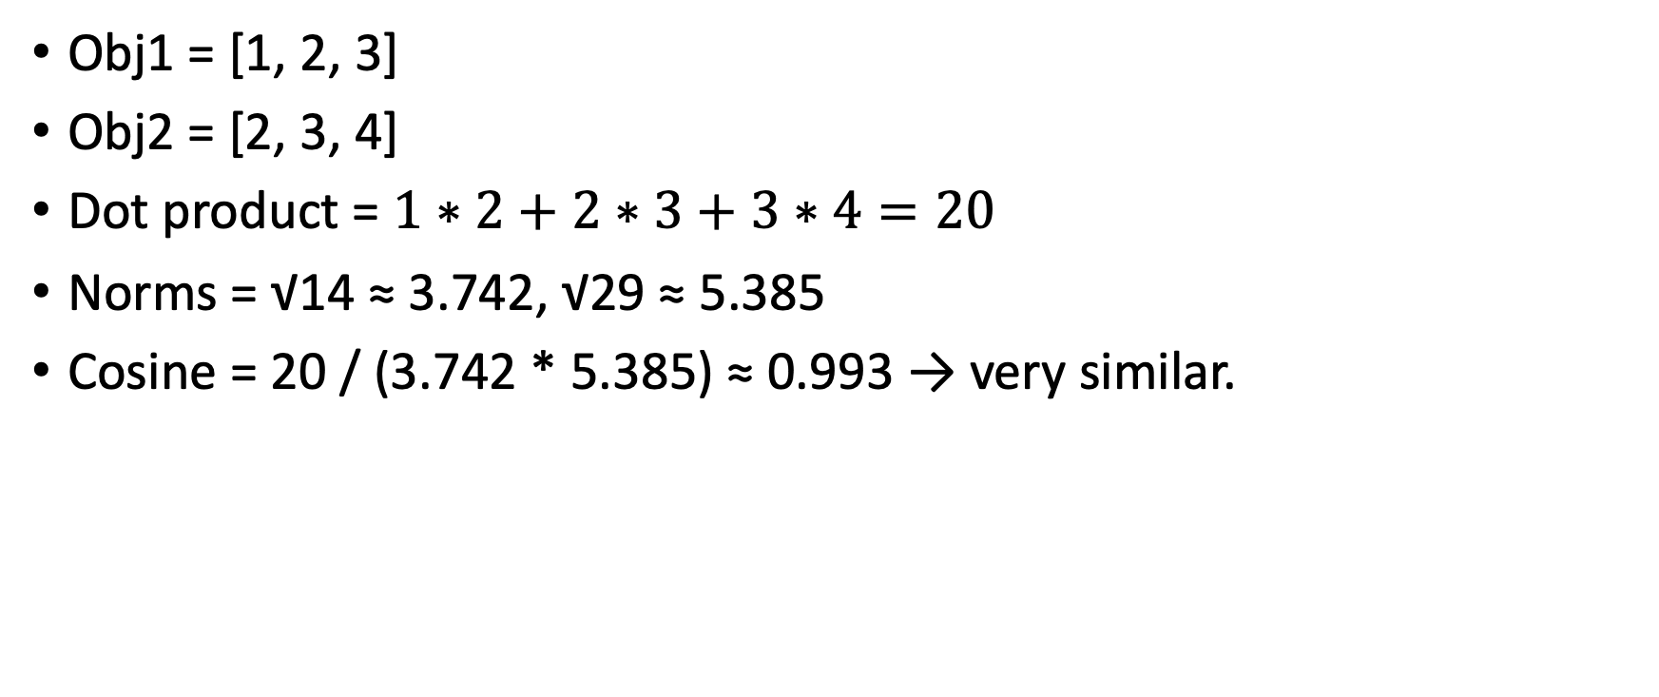
Example of Cosine with Numerical Data
Obj1 = [1, 2, 3]
Obj2 = [2, 3, 4]
Dot product = $1∗2+2∗3+3∗4=20$
Norms = √14 ≈ 3.742, √29 ≈ 5.385
Cosine = 20 / (3.742 * 5.385) ≈ 0.993 → very similar.

Slide 67
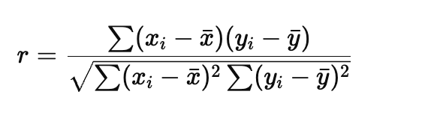
Correlation Analysis
Pearson Correlation Coefficient
Measures linear relationship between two numeric variables
Formula:
Range: [-1, 1]
1: Perfect positive correlation
-1: Perfect negative
0: No linear correlation

Slide 68
Python Libraries
NumPy Numerical computing, arrays
Pandas Data manipulation
Matplotlib Data visualization
Seaborn Statistical data visualization
Scikit-Learn Machine learning algorithms
TensorFlow Deep learning, neural networks
Keras High-level API for deep learning (built on top of TensorFlow)
PyTorch Deep learning (research-focused)
XGBoost Gradient boosting for structured data
LightGBM Fast boosting algorithm
OpenCV Computer vision and image processing
NLTK Natural language processing
SpaCy Advanced NLP

Slide 69
scikit
scikit-learn (sklearn) is a powerful machine learning library in Python that provides tools for:
Data Preprocessing (handling missing data, scaling, encoding)
Feature Extraction (Bag of Words, TF-IDF, PCA)
Supervised Learning (Regression & Classification models)
Unsupervised Learning (Clustering, Anomaly Detection)
Model Selection & Evaluation (Cross-validation, Hyperparameter tuning)

Slide 70
Task 1: Load & Explore a Dataset
import pandas as pd
df = pd.read_csv('data.csv') # Load dataset
print(df.head()) # Show first 5 rows
print(df.info()) # Dataset summary
print(df.describe()) # Statistical summary

Slide 71
Task 2: Train-Test Split
from sklearn.model_selection import train_test_split
X = df.drop('Target', axis=1) # Features
y = df['Target'] # Labels
X_train, X_test, y_train, y_test = train_test_split(X, y, test_size=0.2, random_state=42)
Task 3: Linear Regression
from sklearn.linear_model import LinearRegression
model = LinearRegression()
model.fit(X_train, y_train) # Train model
y_pred = model.predict(X_test) # Make predictions
The random_state parameter ensures that the data split is reproducible. It controls the randomness of the train-test split, meaning:
Same random_state → Same Split Every Time Different random_state → Different Split Every Time
Notes:
Why Use random_state?
In machine learning, you often compare models. If the data splits change every time, the results will fluctuate, making it hard to compare models.
Setting random_state ensures that every run has the same train-test split, allowing consistent results.

Slide 72
Task 4: Logistic Regression
from sklearn.linear_model import LogisticRegression
from sklearn.metrics import accuracy_score, classification_report
clf = LogisticRegression()
clf.fit(X_train, y_train)
y_pred = clf.predict(X_test)
print("Accuracy:", accuracy_score(y_test, y_pred))
print(classification_report(y_test, y_pred))

Slide 73
X_train, X_test, y_train, y_test = train_test_split(X, y, test_size=0.2, random_state=42)
Hold out Method: 20% hold out

Slide 74
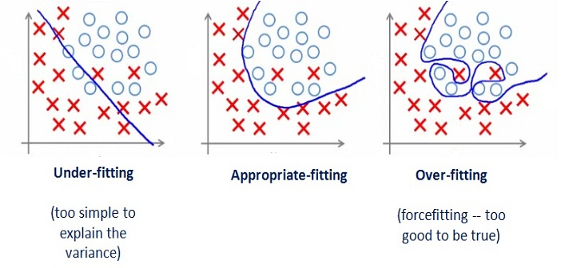

Slide 75


Slide 76
Cross-Validation
Cross-validation divides the dataset into multiple "folds." \The model is trained on a subset of these folds and evaluated on the remaining "holdout" fold.
This process is repeated multiple times, with different folds serving as the holdout set each time.
The performance metrics are then averaged across all iterations, providing a more reliable estimate of the model's generalization ability on unseen data.
This helps identify overfitting, as an overfit model will show a significant drop in performance on the holdout folds compared to the training folds.

